Slide 1


Slide 2
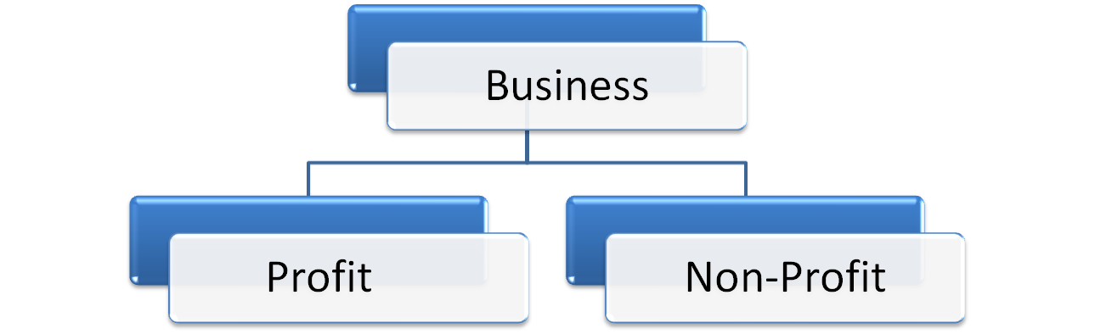
Introduction to Business.
Sole Proprietorship
Club
Partnership
Hospital
Company
Library

Slide 3
Introduction to Accounting:
Accounting is an art of :
Recording,
Classifying,
Summarising; and
Reporting of transaction with the aim of showing the financial health of the business.
It is said that accounting is the language of business.

Slide 4
Definition of Accounting:
The American Institute of Certified Public Accountants (AICPA) had set up a committee on terminology in the year 1961 and the said committee defined Accounting as “an art of recording, classifying and summarizing in a significant manner and in terms of money, transactions and events which are, in part at least, of a financial character and interpreting the result thereof”.

Slide 5
Objectives of Accounting:
To keep systematic records.
To ascertain profit and loss for a period (usually a year)
To ascertain the financial position as at a particular period.
To provide accounting information to interest parties ( Owners, Manager, Lender, Creditors, Investors, Tax Authorities, Employees etc.)

Slide 6
Accounting Terminology:
Capital: Capital means the amount (in term of money or assets having money value) which the entrepreneur has to invest in the business.
Liabilities: Any amount payable to the Outsider (Creditors) is called a Liability. Liabilities can be divided into two categories, viz., Long-Term Liabilities and Short-Term Liabilities.
Assets: Those valuable items which are owned by the business and helps in smooth running of the business are called Assets. Assets can be divided into two types, viz., Fixed Assets and Current Assets.
Debtors: A person who owes money to the business firm generally on account of credit sales of goods is called Debtors.

Slide 7
Creditors: A person to whom the firm owes money is called a Creditor.
Stock: The terms ‘Stock’ includes goods lying unsold on a particular date. The stock may be Opening Stock and Closing Stock. Opening Stock means goods lying unsold in the beginning and Closing Stock means goods lying unsold at the end of the accounting period.
Income: Income is the Profit earned by the firm during a period of time. In other words, the difference between revenue and expense is called Income.
Loss: Loss means something against which the firm receives no benefit. In other words, loss means the excess of expenses over revenue.

Slide 8
Proprietor: The person who makes the investment and bears all the risks connected wit the business is called the Proprietor.
Drawings: It is the amount of money or the value of goods which the proprietor takes for his personal use.
Purchases: The term Purchases is used only for the purchase of goods. The term purchases include both Cash and Credit purchases of goods.
Sales: The term Sales is used for the sale of goods . The term sales include both Cash and Credit sales of goods.

Slide 9
Gross Profit: This is the difference between the Sales revenue or the proceeds of goods and/or services rendered over its direct cost.
Net Profit: Net profit is the profit made after allowing for all expenses. In case, expenses are more than the revenue, it is Net Loss.
Entry: The record of a transaction or event in the books of accounts is known as entry.
Transaction: Any exchange of goods or services, for cash or on credit by the business with other business.
Account: An account is a summarized record of relevant transactions at one place relating to a particular head. It records not only the amount of transactions but also their effect and direction.

Slide 10
Process of Accounting:
Financial Transactions
Analysis & Interpretation
Recording (Journal)
Summarizing:
Trail Balance.
Trading and P/L a/c.
Balance Sheet.
Classification (Ledger)

Slide 11
Basic Accounting Procedures:
A. Traditional Approach:
Real Accounts:
Dr: What comes in
Cr: What goes out
Dr: The Receiver
Cr: The Giver
Personal Accounts:
Nominal Accounts:
Dr: All Expenses and Losses
Cr: All Incomes and Gains

Slide 12
B. Modern Approach:
Assets:
  Increases in assets are debits; decreases are credits.
Liabilities:
Increases in liabilities are credits; decreases are debits.
3. Capital:
Increases in capital are credits; decreases are debits.
4. Revenue/Income:
Increases in revenue are credits; decreases are debits.
5. Expenses:
    Increases in expenses are debits; decreases are credits.

Slide 13
Types of Accounting
Financial Accounting
Cost Accounting
Management Accounting

Slide 14
Users of Accounting
Internal Users
External Users
Board of Directors.
Partners.
Managers.
Officers
Investors.
Lenders.
Suppliers.
Government Agencies.
Labour Union.
Employees.
Customers.
Research Scholars.

